Slide 1
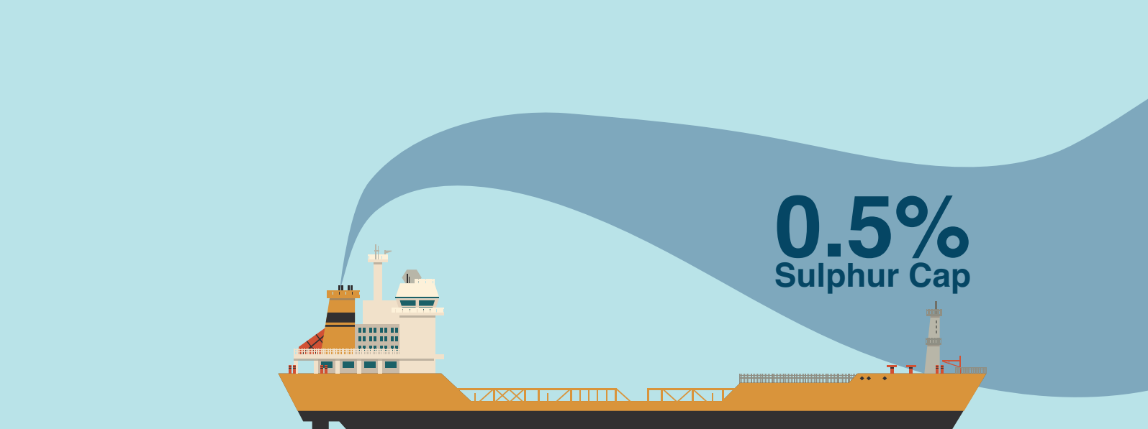
IMO 2020 sulphur cap: experience so far
ELINT ANNUAL MEETING OF MARINE TECHNOLOGY
December 2020
Stavros Hatzigrigoris

Slide 2
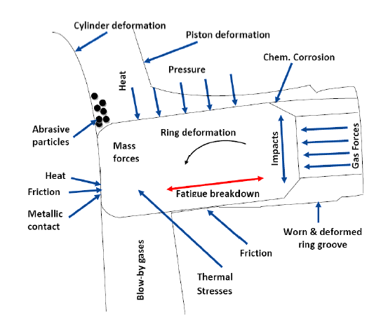
M/E scuffing incidents
We have seen an increased number of scuffing incidents over the last two years.
Scuffing is a form of adhesive wear caused by hard, metal to metal contact between cylinder liners and piston rings due to oil film breakdown.
Scuffing may cause catastrophic damages in cylinder liners, piston rings, piston rods, stuffing boxes and may lead to complete immobilization of the vessel.
These incidents may or may not be directly related to the use of VLSFO.
Experience has shown that the cylinder condition tribology of the latest ultra-long stroke, slow speed Main Engines is complicated due to:
high Pmax which means the higher mechanical load on piston rings, liners, and cylinder oil,
-higher cooling jacket temperatures to fight cold corrosion which means higher heat loads, -
longer stroke at low speeds which is challenging for the build-up of hydrodynamic oil films.

Slide 3
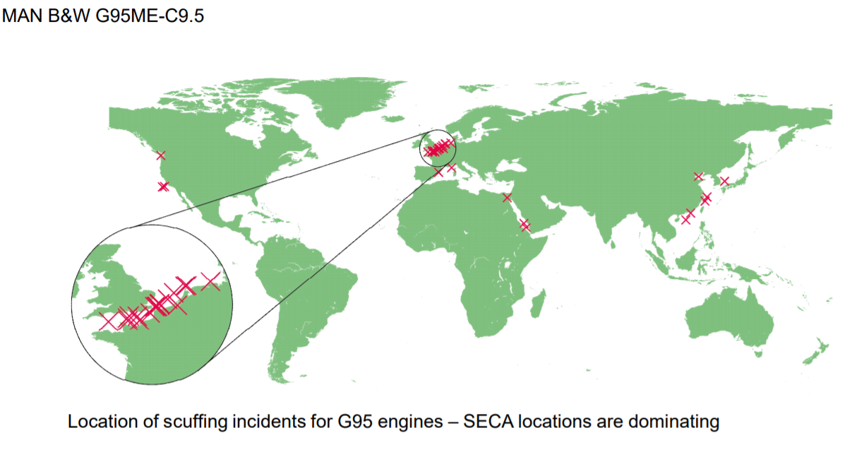
M/E scuffing incidents
On the other hand, fuels with low %S (VLSFO and MGO) do not provide to the cylinder liner the controlled sulphuric corrosion required to keep an open graphite structure.
An amount of controlled corrosion is desired for cylinder liners to avoid the bore polishing phenomenon.
Furthermore, cylinder oil manufacturers and M/E makers had to go through a steep learning curve to be able to “match” the cylinder oils with engine profile and VLSFO.
Everybody is going through an “experience-building phase” as far as the cylinder lubrication is concerned.
More frequent, meticulous M/E scavenge space inspections and cermet coated piston rings are a must from now on.

Slide 4
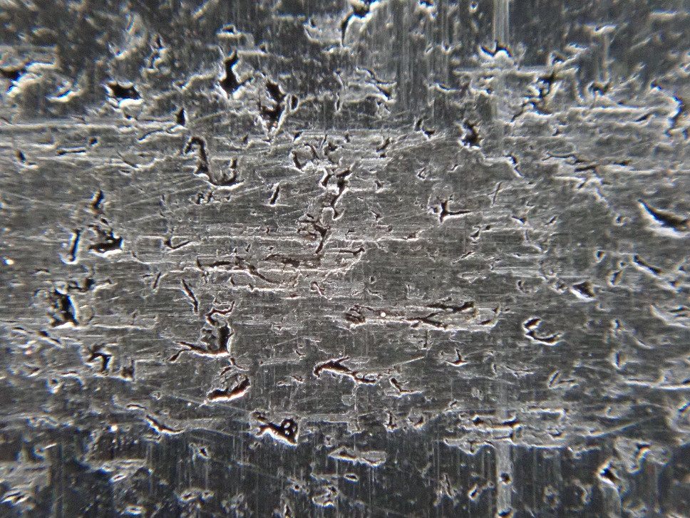
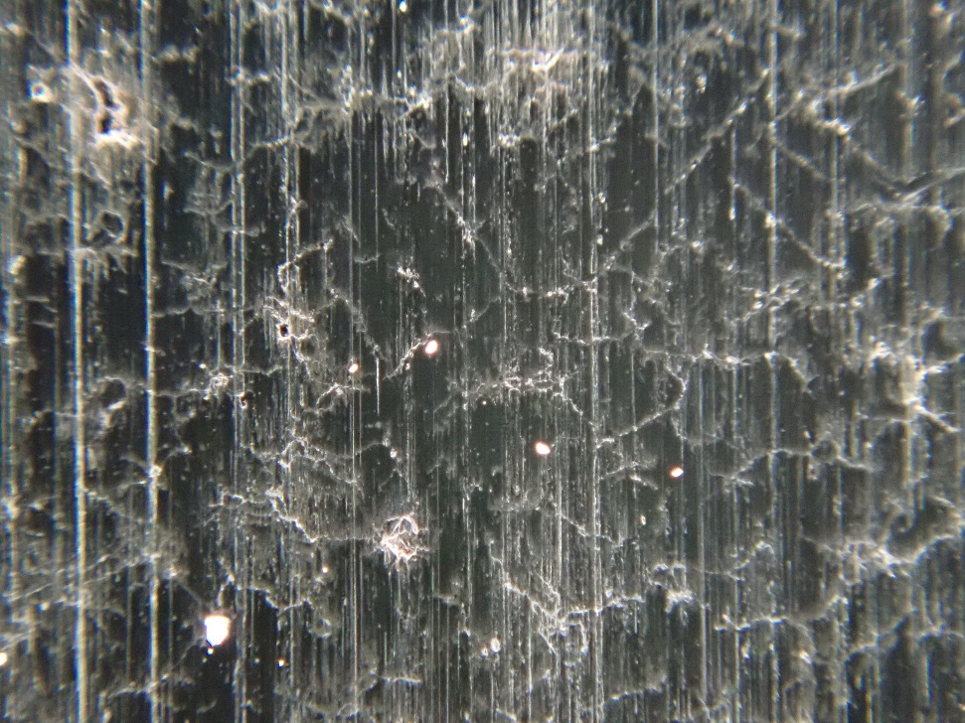
Open and closed graphite microstructures of cylinder liner
Open graphite structure – healthy lower part of a cylinder liner in way of the wave cut marks. Proper build-up of oil film
Closed graphite structure – heavily scuffed upper part of the liner.
Not proper build-up of oil film.
Wave cut mark

Slide 5
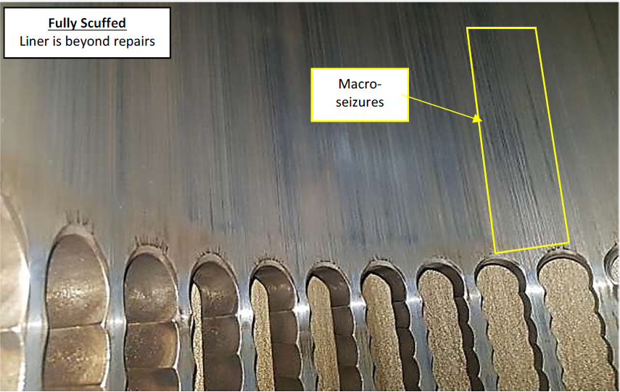
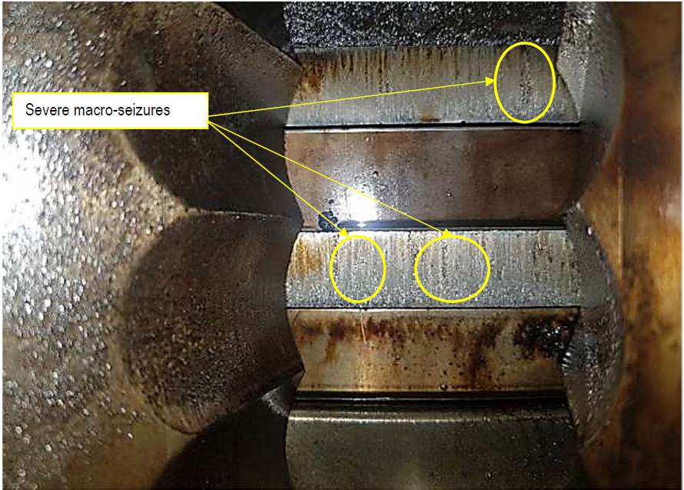
M/E scuffing damages

Slide 6
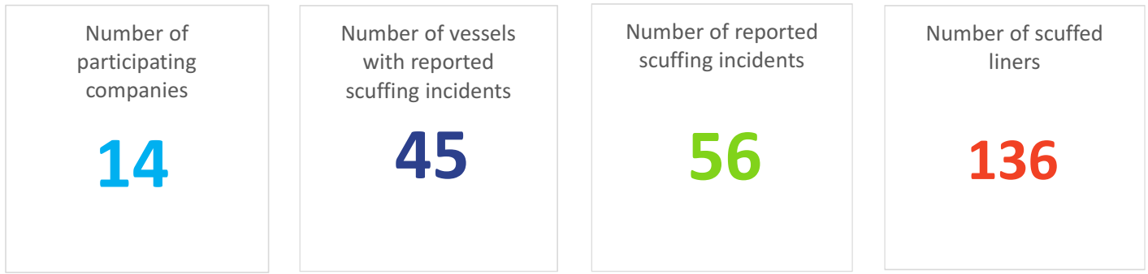
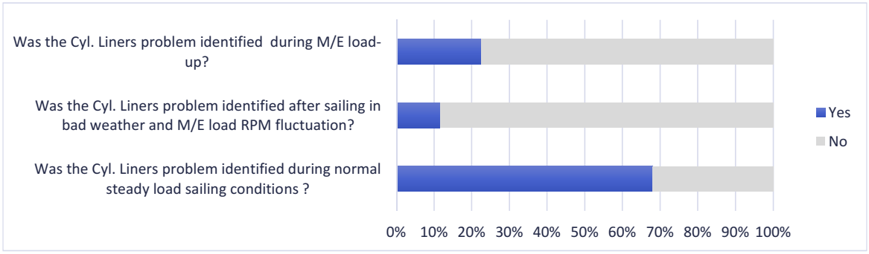
Martecma | Scuffing experience survey
From May 2019 to June 2020, a Scuffing Experience Survey was carried out by Martecma that collected and analyzed data on operational problems related to scuffing.
In total, 14 companies contributed to the survey, and 45 vessels reported scuffing incidents.
The number of the reported scuffing incidents was 56 which means there are vessels with more than one scuffing incident.
During that period, 136 liners were scuffed.
Most of the cylinder liners problems were identified during normal steady load sailing conditions.
6

Slide 7
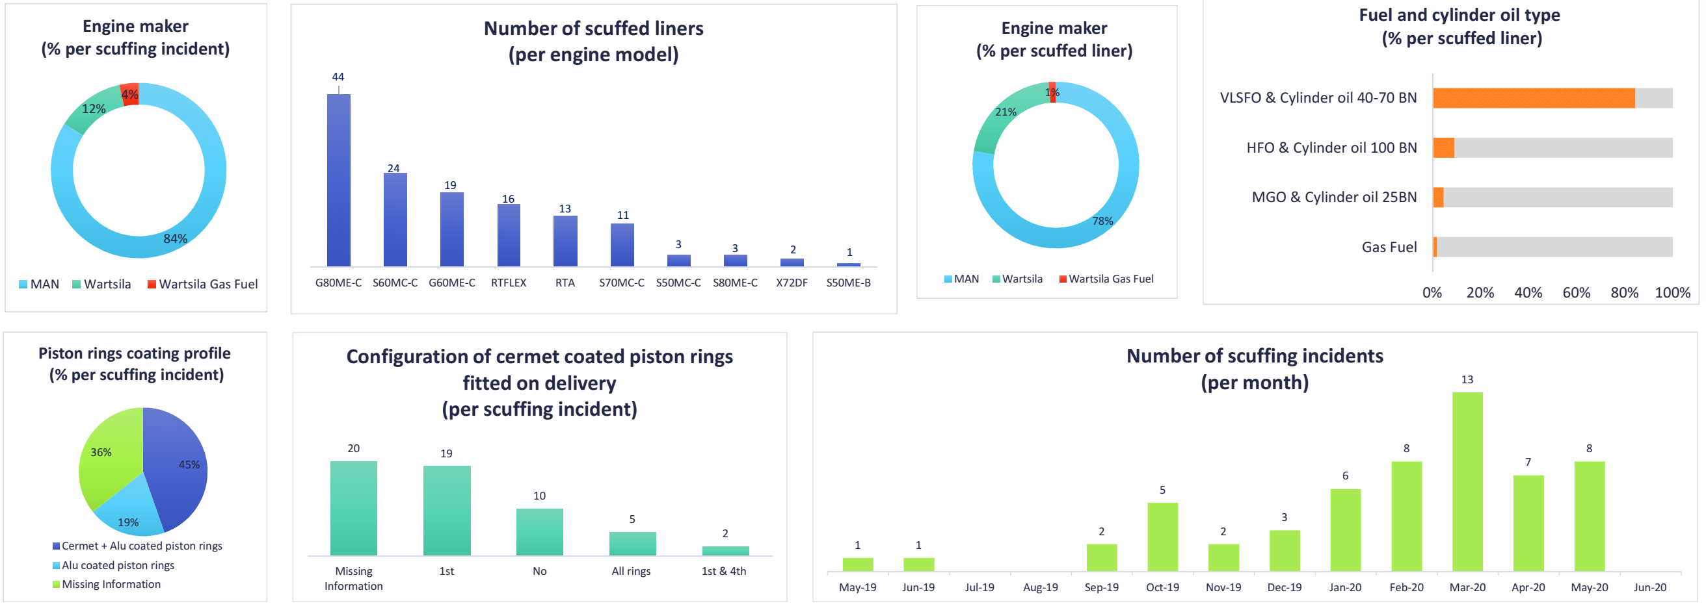
Martecma | Scuffing experience survey
7

Slide 8


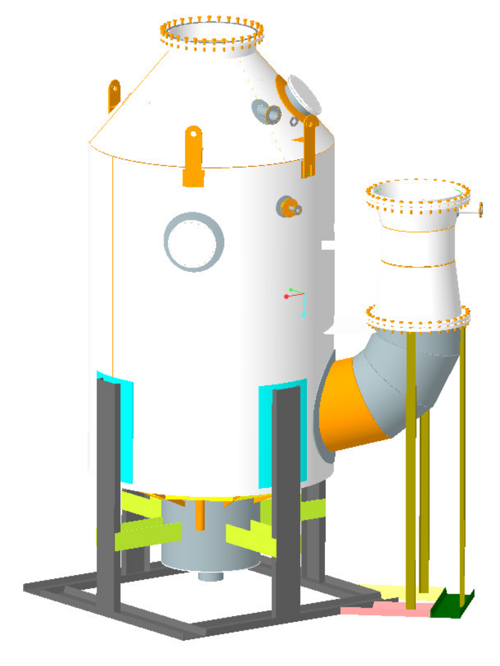
Martecma/DNV GL | Operational experience survey on LSFO and EGCS
A joint 2020 Fuel Oil and EGCS Operational Experience Survey carried out intended to gain deeper insights with the availability and use of the new compliant fuels and the operation of Exhaust Gas Cleaning Systems.
Through the Survey, responses received from 49 vessel owners for total 895 ships.
Most operators (65%) experienced problems with the new compliant fuels after 1st January 2020.
Ten of the 49 companies participated in the survey have invested in SOx scrubbers' installations on 177 vessels out of the 895 vessels participating in the survey.
Eight out of the ten (80%) companies invested on EGCS have reported quality issues on the use of HFO, mainly related to the stability and total sediments, acid number and catfines.
49
companies
895
vessels
117
EGCS
8

Slide 9
Martecma/DNV GL | Operational experience survey - LSFO issues
Availability
No significant issue of compliant fuel (VLSFO or MGO) availability at their area of operations was reported. However, few operators had to apply for a Fuel Oil Non-Availability Report and the process was smooth with no significant delays or other issues.
The main quality issues related with the fuel oil stability and total sediments, the high pure point, above specification sulfur content and high viscosity. Other issues reported related with increased levels of Calcium, High Sediment and Wax Precipitation Point, Excessive sludge/wax formation on FO purifier sludge pipe outlet etc.
A significant number of operators experienced issues with the BDN provided on board and more than half of them had to notify the ship’s Flag Administration for the discrepancy found.
Operators provided efforts mainly on crew training, manual tank cleaning and to provide the correct lubrication oil. Tank cleaning using additives has also utilized by many operators.
A quarter of the ships have not experienced any inspections by the PSC. While those ships inspected documents review and sampling and analysis has mainly been implemented by the PSC officers .
Quality
BDN
SIP
Controls
9

Slide 10
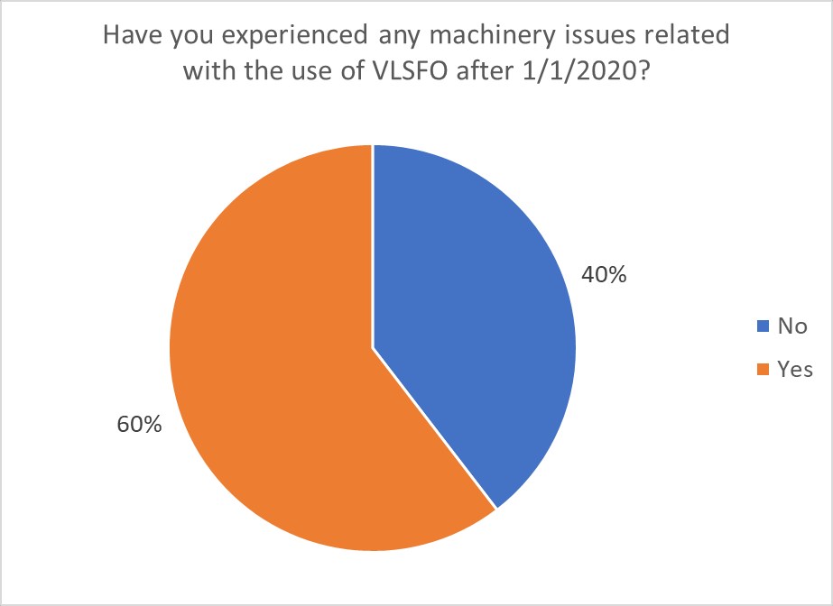
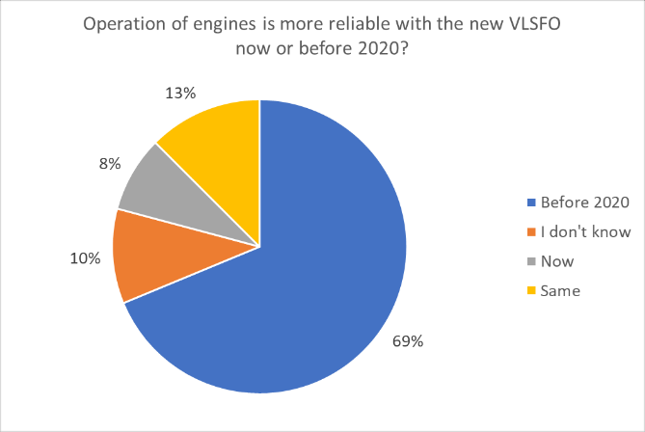
Martecma/DNV GL | Operational experience survey - LSFO issues
HFO ROB
Most of the operators had consumed the non-compliant HFO before 1st January 2020, while those ships that had a remaining quantity on board were able to debunker after 1st January without any serious issues.
Most of the operators believed at the time of the survey in summer 2020 that the VLSFO price will possibly increase in the near future.
Many operators have experienced machinery issues with the use of new fuel oils.
Prices
Machinery
10

Slide 11
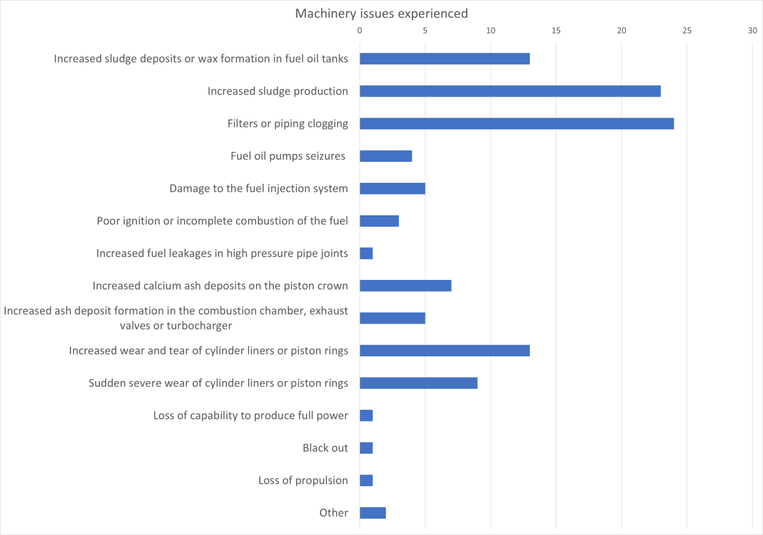
Martecma/DNV GL | Operational experience survey - LSFO issues
11

Slide 12
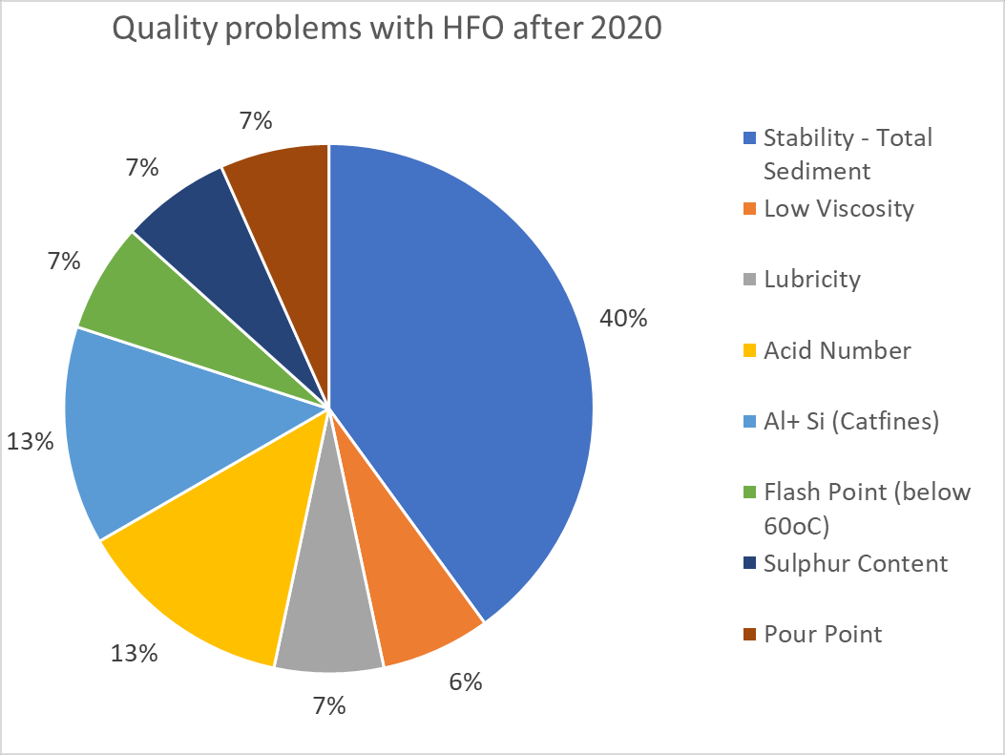
Martecma/DNV GL | Operational experience survey - EGCS issues
Few operators at the time of the survey (summer 2020) were planning to install an EGCS within 2020 and beyond will a significant number believed that the price differential between HFO and complaint VLSFO will increase soon.
Operators reported that currently they can easily find HFO in their area of operation, but they think HFO availability will be reduced in the forthcoming years and especially beyond 2030.
Eight out of the ten (80%) companies invested on EGCS have reported quality issues on the use of HFO, mainly related to stability and total sediments, acid number and catfines.
.
Market
HFO Availability
HFO Quality
12

Slide 13
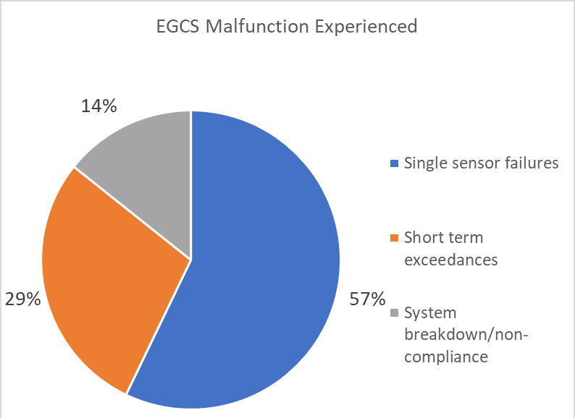
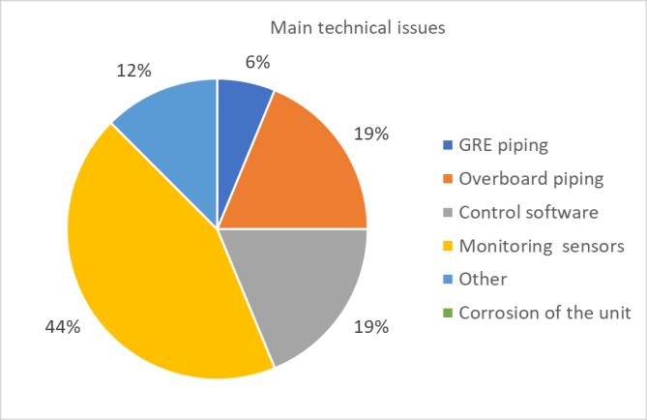
Martecma/DNV GL | Operational experience survey - EGCS issues
It appears that a significant number of ships (about 31%) have not experienced any inspections by the PSC. While those ships inspected documents and records review and EGCS inspection has mainly be implemented by the PSC officers. No ship received any penalty or fine.
Ships operators believe that there will be additional restrictions in the future (mainly national and regional) on the discharge water while the list of ports with discharge prohibitions will increase.
Single sensor failure is the more frequent EGCS malfunction experienced following by short term exceedances and then system breakdown. Technical issues faced are related mainly with issues on monitoring sensors, software problems and overboard piping corrosion.
Controls
Discharge Water
Technical Issues
13

Slide 14

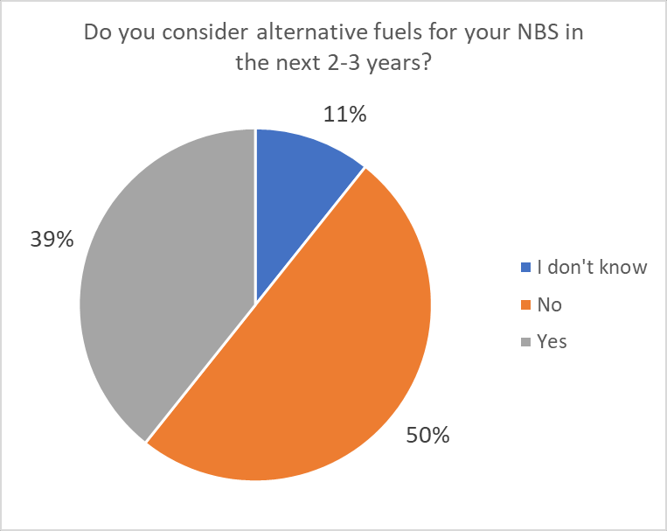
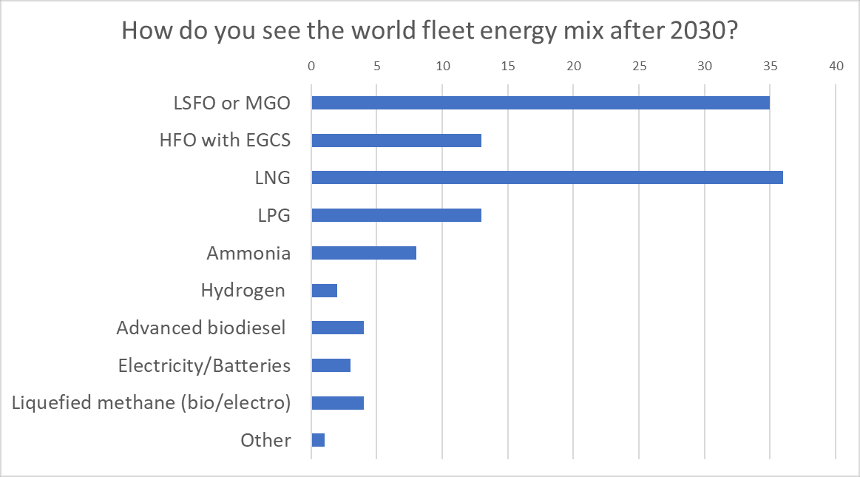
Martecma/DNV GL | Operational experience survey - Future
14

Slide 15
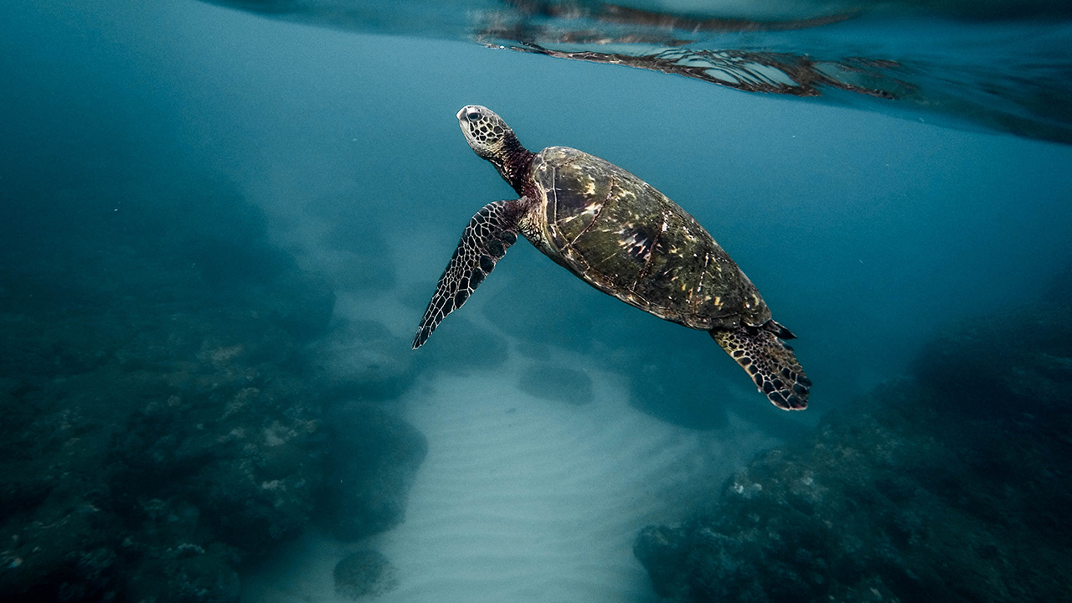
Approach 13: New/ innovative emission reduction mechanism.
State or IMO funded research.
Collaboration between ship operators, universities, class societies, makers and charterers.
Research with a practical perspective, “abstract” science to be avoided.
No focus in technology only.
Thank you!

