Slide 1



CATHODIC PROTECTION APPLICATIONS
ENVIRONMENTAL PROTECTION ENGINEERING S.A.
Dr Evripidis Tsergas
Mechanical & Cathodic Protection Engineer
Notes:
Cover for Services

Slide 2
Company’s Profile
ENVIRONMENTAL PROTECTION ENGINEERING S.A. (EPE S.A.) was established in Piraeus in 1977 and is one of the major companies in the field of environmental protection, offering a variety of services and products in the marine and industrial field.
Two of the activities that EPE S.A. has focused on are Cathodic Protection and Anti-Fouling technologies.
EPE has executed numerous international projects for sub-sea infrastructure, on-shore and off-shore structures, underground pipelines, wind farms, jetties, merchant ships and yachts
EPE is currently the biggest manufacturer of sacrificial anodes in Greece
The product range includes:
Sacrificial Anodes Cathodic Protection (SACP)
Impressed Current Cathodic Protection (ICCP)
Impressed Current Anti-Fouling (ICAF/MGPS)

Slide 3
Integrated Solutions
ENVIRONMENTAL PROTECTION ENGINEERING S.A. (EPE S.A.) is capable of providing integrated solutions concerning Cathodic Protection and Anti-Fouling systems. The steps we follow to execute a project are:
Identification of customer’s requirements
Preparation of alternative technical solutions by using simulation tools for systems optimization
Project management
Systems production and/or assembly
Commissioning, monitoring, maintenance and retrofits
Assessment of systems performance and reporting

Slide 4
Sacrificial Anodes CP Systems (SACP)
EPE S.A. designs and manufactures Sacrificial Anodes under the registered trademark "POLCOR®".
The Zinc and Aluminum based alloy sacrificial anodes are produced in the company’s factory in Greece, with the highest internationally approved standards of quality, safety and environmental protection.
We are certified by Lloyd’s register, ISO 9001:2015, ISO 14001:2015, Eurocert, OHSAS 18001:2007, Lloyd’s Type Approval Certificate for Aluminum and Zinc based alloy sacrificial anodes, Lloyd’s register for long term Performance Test of POLCOR Sacrificial Alloy Anodes according to Appendix C of DNV RP-B401:2010.
The company operates a fully equipped laboratory for the analyses of the chemical composition and electrochemical characteristics.
Furthermore, there is the possibility to produce any specification upon request and to advice and guide customers as to the most suitable alloy and configuration for a given issue.

Slide 5
Sacrificial Anodes CP Systems (SACP) (cont’d)
EPE S.A. has successfully completed several projects concerning Sacrificial Anodes Cathodic Protection Systems in the Marine, Oil & Gas and Sustainable Energy industries and infrastructure, in many countries around the world. More specifically, Sacrificial Anodes Cathodic Protection Systems have been provided for the corrosion protection of the following:
Marine Industry
Ships hulls
Rudders
Propeller Brackets
Bow thrusters
Sea chests
Ballast tanks
EPE S.A. is capable of providing optimised studies for vessels Sacrificial Anodes Cathodic Protection systems, along with consultancy concerning the anodes arrangement.

Slide 6
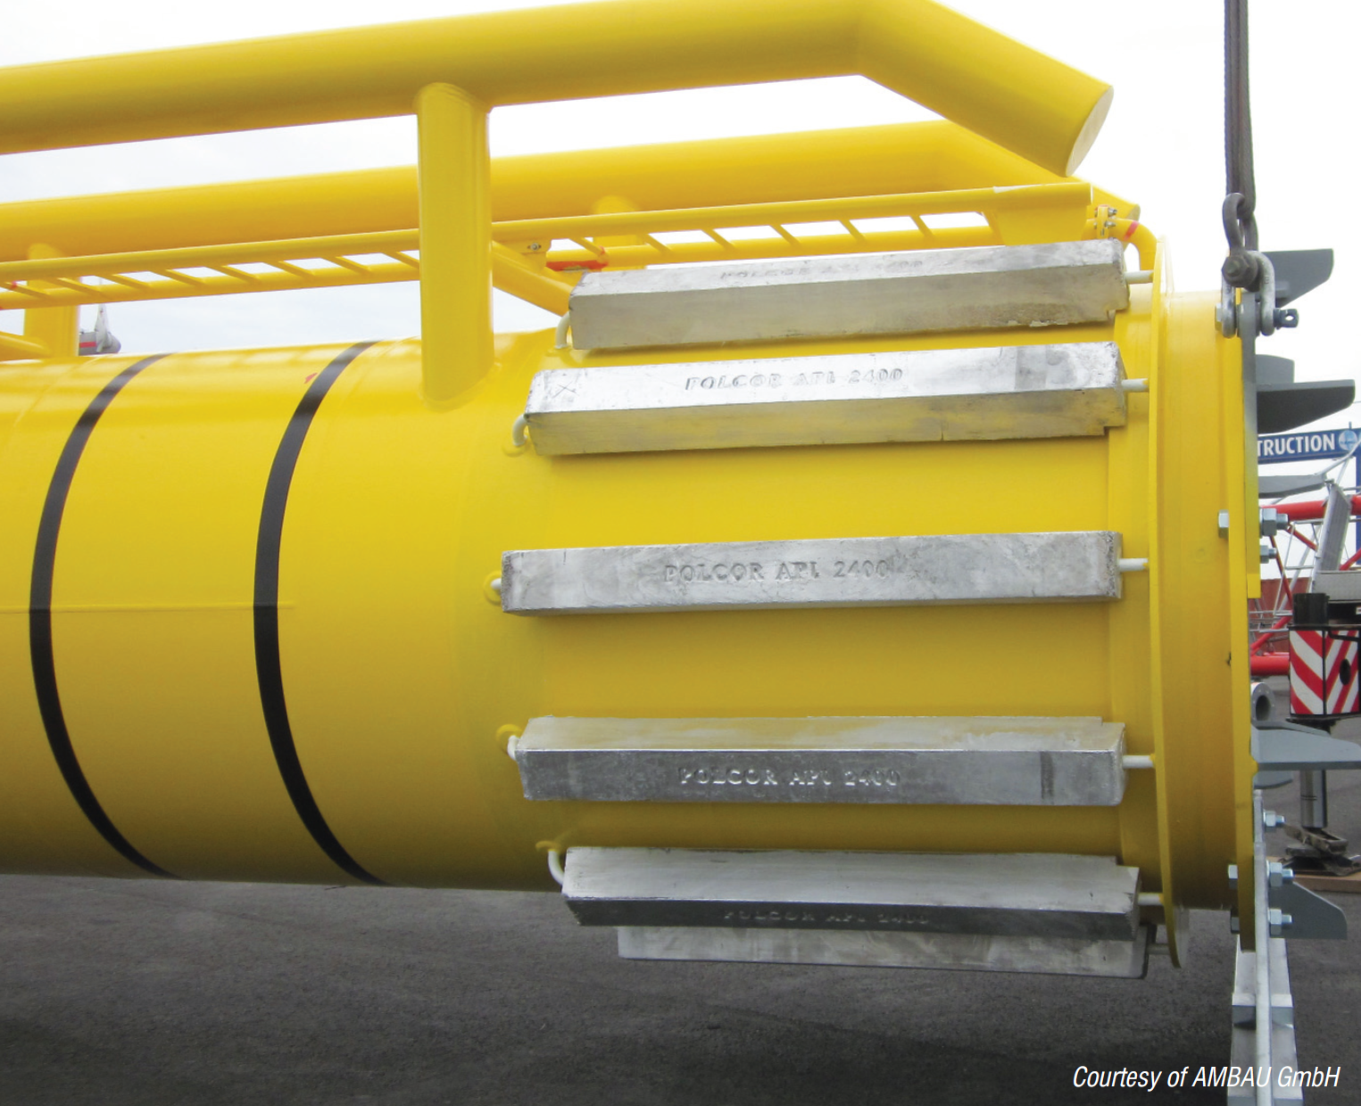
Sacrificial Anodes CP Systems (SACP) (cont’d)
Oil & Gas and Sustainable Energy Industries
Subsea Pipelines
Off-Shore Wind Farms
Jetties
Infrastructure
Floating Docks
Seawater Intakes
Port Doors

Slide 7

Sacrificial Anodes CP Systems (SACP) (cont’d)
R&D
Cathodic Protection Systems R&D Project
EPE S.A. self-funds R&D projects in order to optimise the Cathodic Protection systems offered to its clients, respecting the industrial regulations concerning the environmental protection.
In this respect, EPE S.A.:
Optimises Sacrificial Anodes Alloys performance in terms of current output and electrochemical capacity.
Identifies methods for minimising the impact of the use of Sacrificial Anodes on the environment.
Applies research on Cathodic Protection methods for new composite materials in Marine environments and elsewhere.

Slide 8
Impressed Current CP Systems (ICCP)
EPE S.A. is capable of delivering Impressed Current Cathodic Protection systems which operate continuously supplying sufficient cathodic current.
The ICCP system is applicable to vessels, off-shore and sub-sea structures.
EPE S.A. can offer services of controlling, measuring, monitoring and reporting on the operation Cathodic Protection System on site or remotely.
EPE S.A. has the capability to assist vessels to replace ICCP with Sacrificial Anodes and vice versa.

Slide 9
Anti-Fouling Systems
Marine Growth Protection System (ICAF/MGPS)
EPE S.A. offers complete M.G.P.S. systems, which can be placed either on sea chests or strainers.
EPE S.A. is also involved in alternative Anti-fouling technologies:
- Low Frequency Audio Signals Anti-Fouling System
Marine organisms are prevented from settling as those audio signals are perceived as predator.
- Ultra-Sonic Anti-Fouling System
Produces microscopic bubbles on the protected surfaces, which prevent the attachment of fouling organisms.

Slide 10

THANK YOU!

