Slide 1

The Challenge
of Maintaining Complex Marine Systems
The case of
EXHAUST GAS
&
BALLAST WATER
TREATMENT SYSTEMS
Rizos Krikkis
Mechanical Engineer , PhD

Slide 2
The establishment of
OCEANKING ENGINEERING PC
by OCEANKING SA
Objectives | Activities
Meet the demand of the Greek owned fleet for technical support. Adapt to an increasingly technically intensive marine environment. | Field Engineering. Training Analytical Engineering

Slide 3
Maintaining Complex Systems
Challenges | Solutions
Systems requiring knowledge in several fields: Mechanical (pumps, compressors, remote controlled valves). Electrical. Chemical (Sea water chemistry). Electronic (high voltage, high frequency power electronics). Software (integration of several different plc’s). Interactions with major ship’s systems: Main Engine Diesel Generators Ballast Pumps Alarm Monitoring and Control System. | Qualified and Experienced Field Engineers. Continuous Personnel training. Expertise in cutting edge engineering technologies (ozone).
The establishment of
OCEANKING ENGINEERING PC
by OCEANKING SA

Slide 4
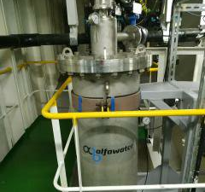
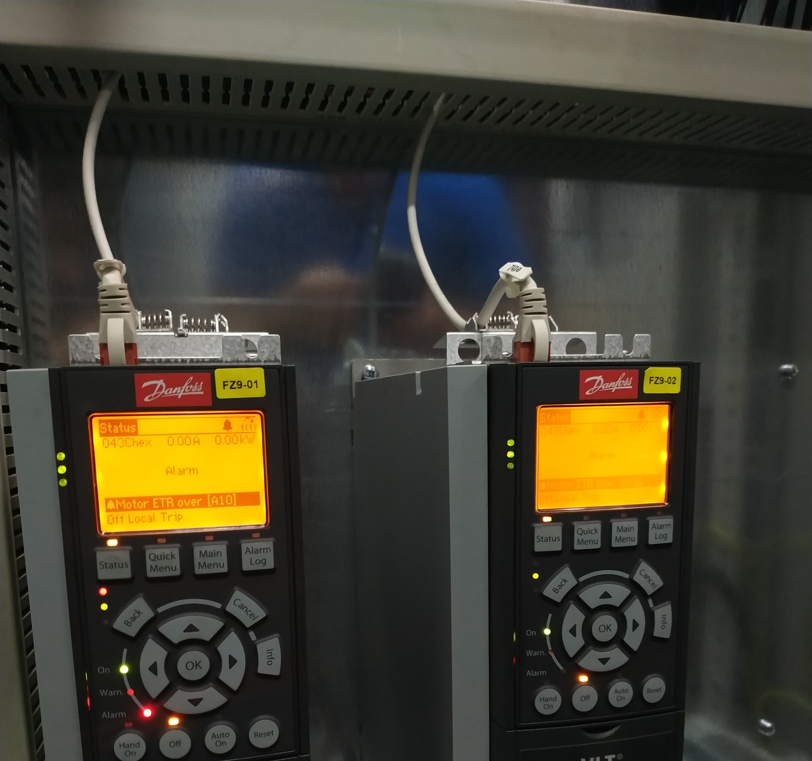
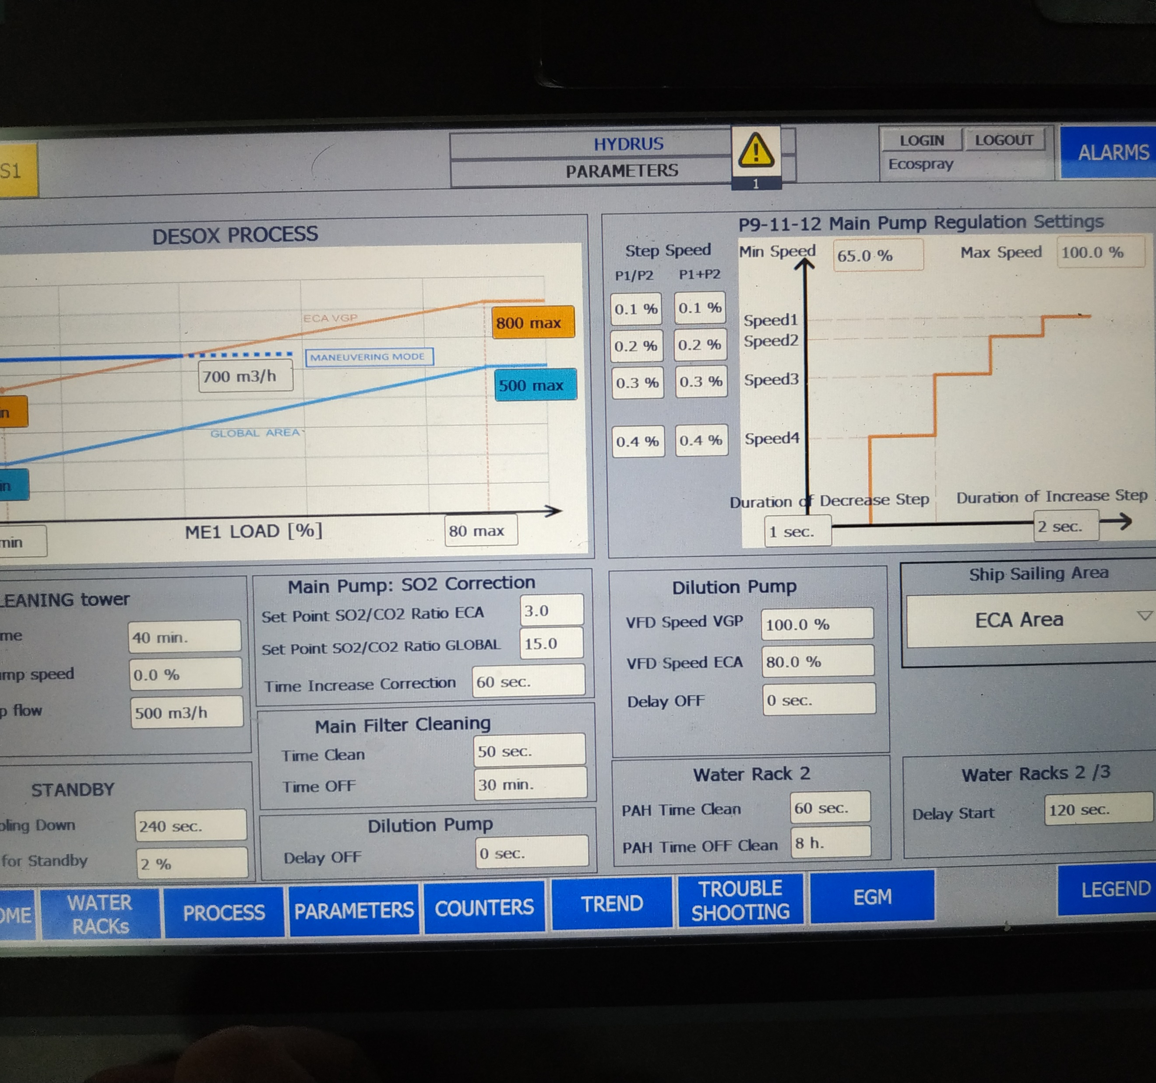
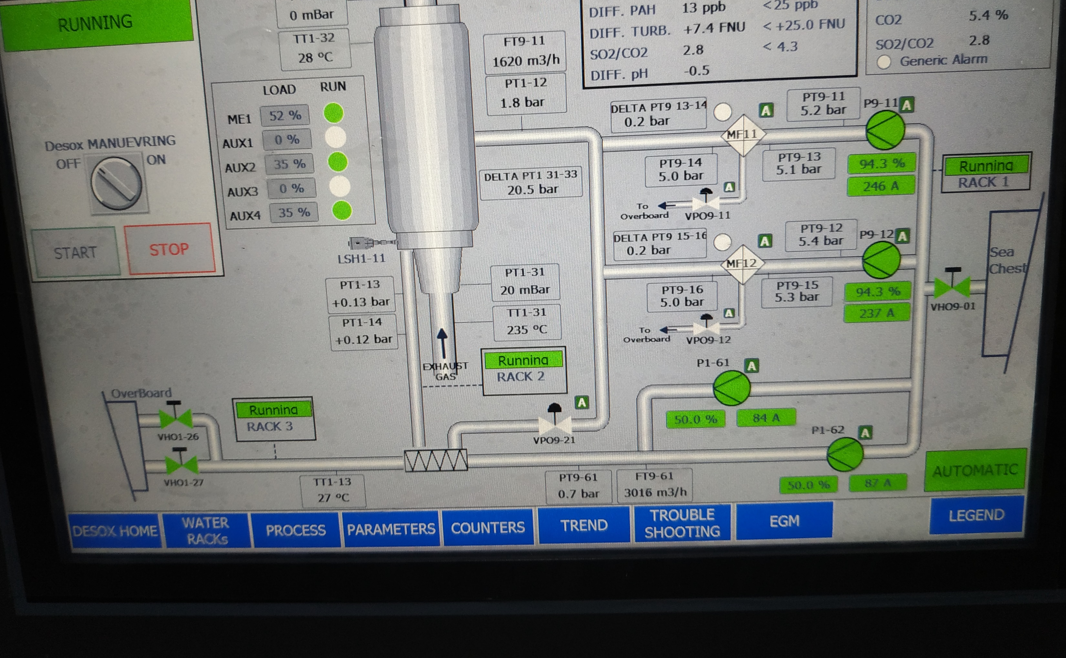
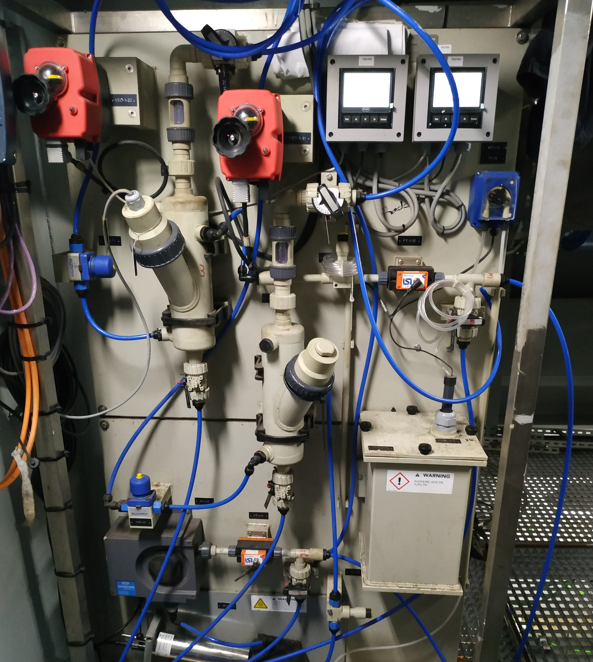
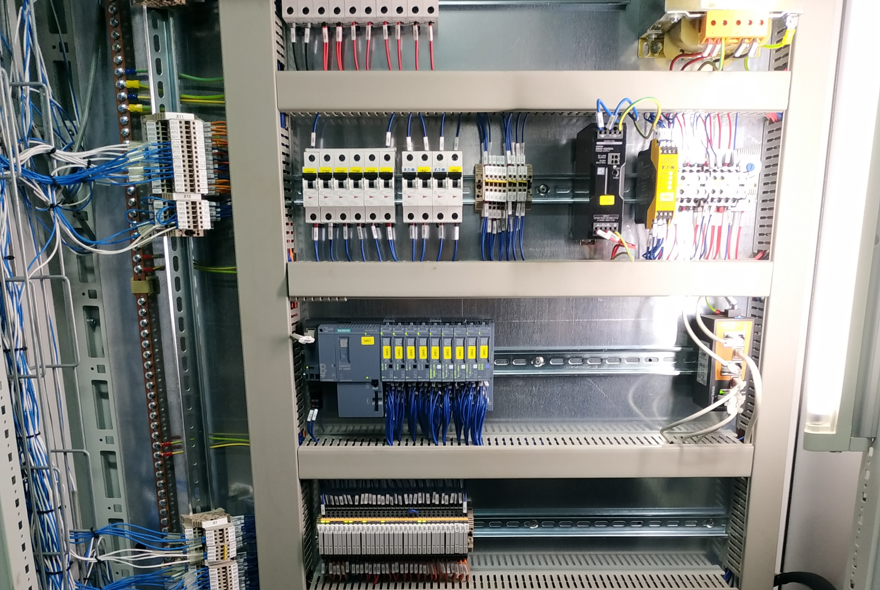
Exhaust Gas
Treatment Systems

Slide 5
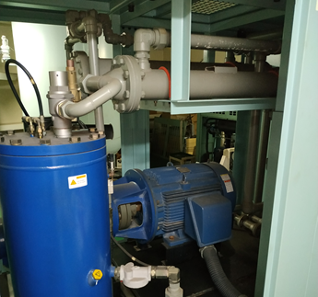
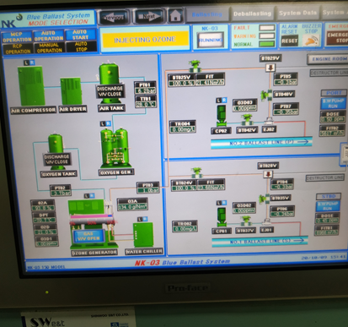
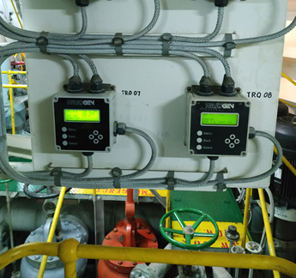
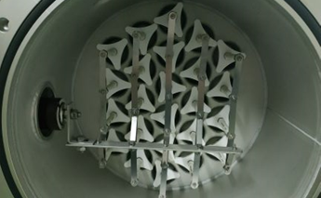
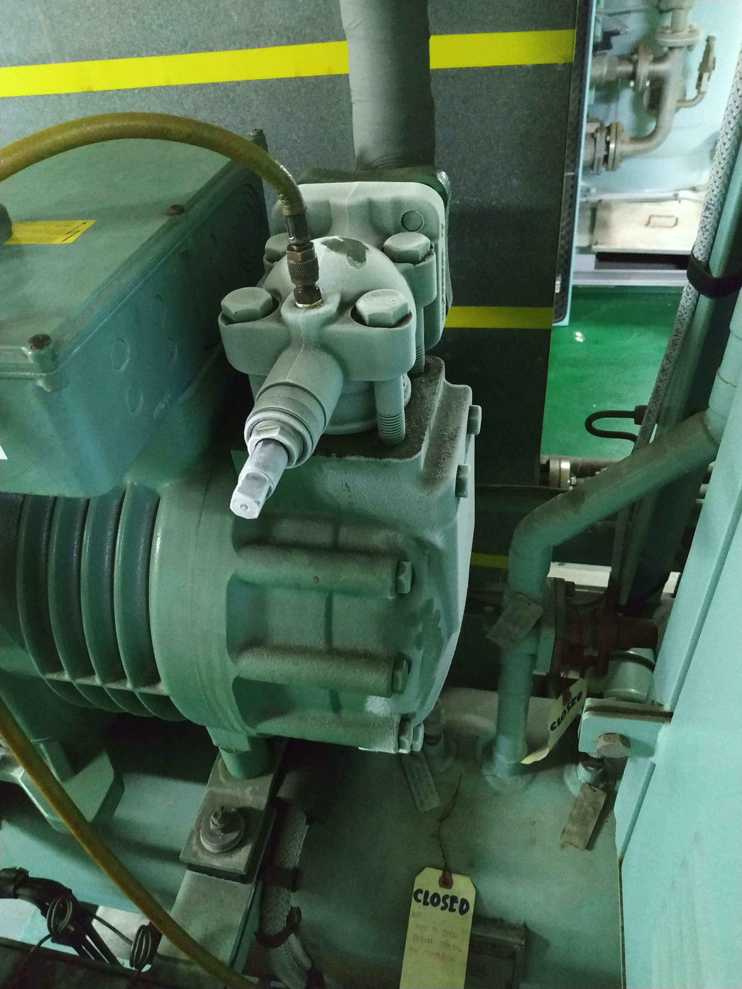
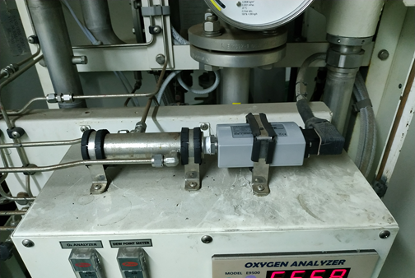
Ballast Water
Treatment Systems

Slide 6
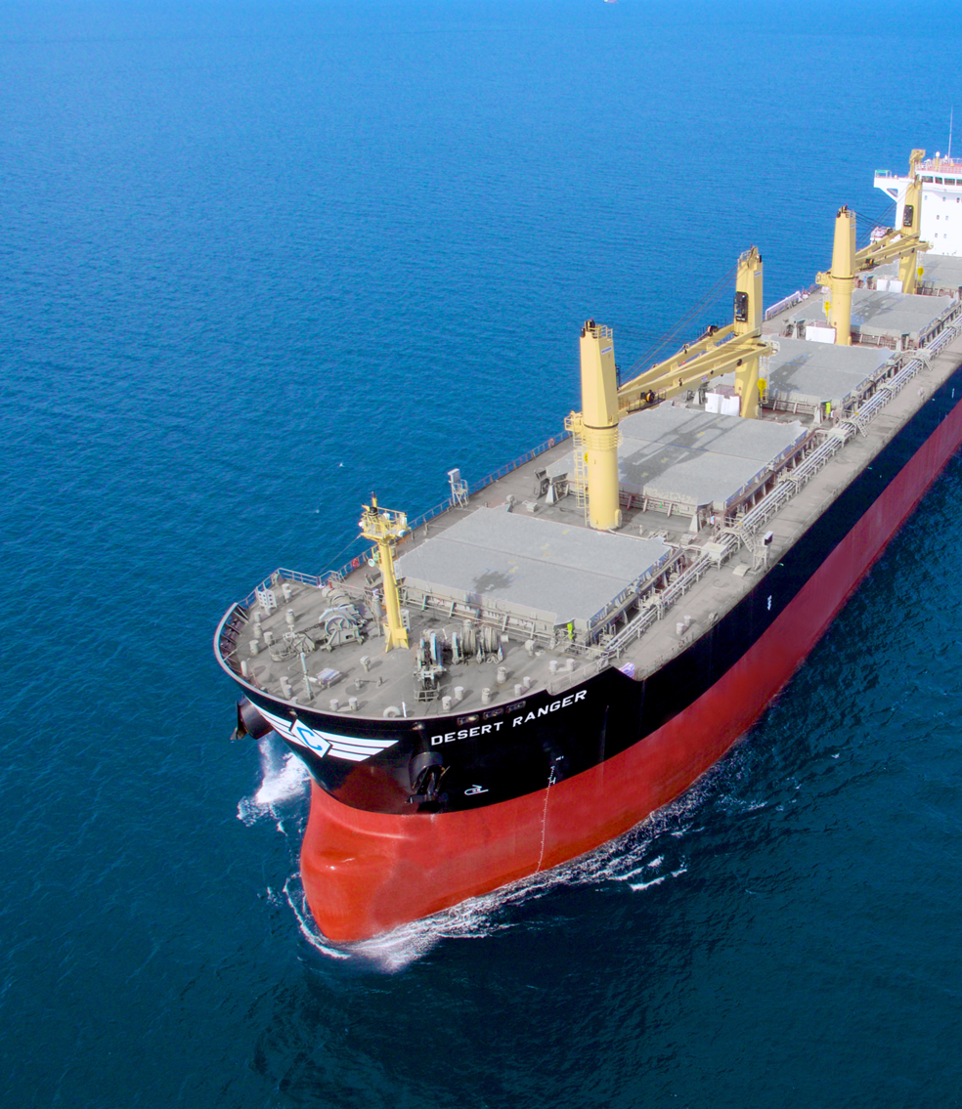
Service Experience
More than 60 vessels serviced (2020).
Multi-disciplinary troubleshooting approach is generated.
Enabling sub-systems improvement and optimization (i.e. new sensors and more robust automatic control).
Plan to introduce new materials and technologies for reducing power consumption and increasing safety and reliability.

Slide 7
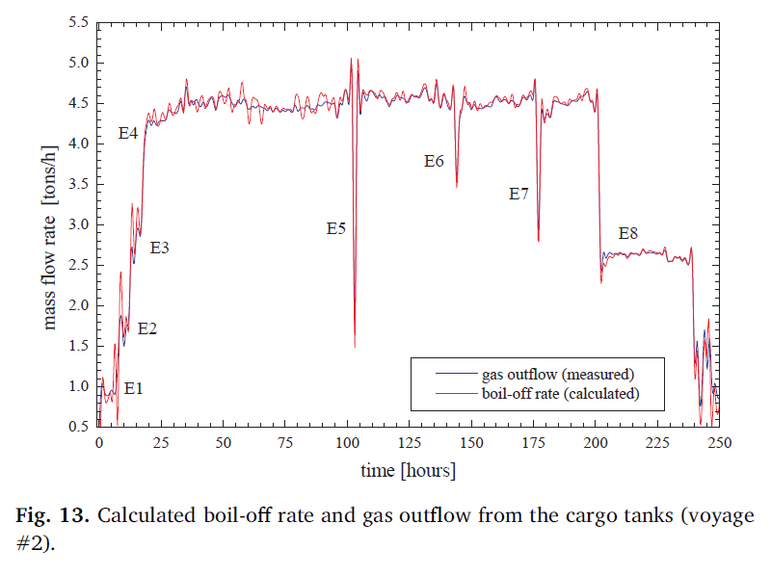
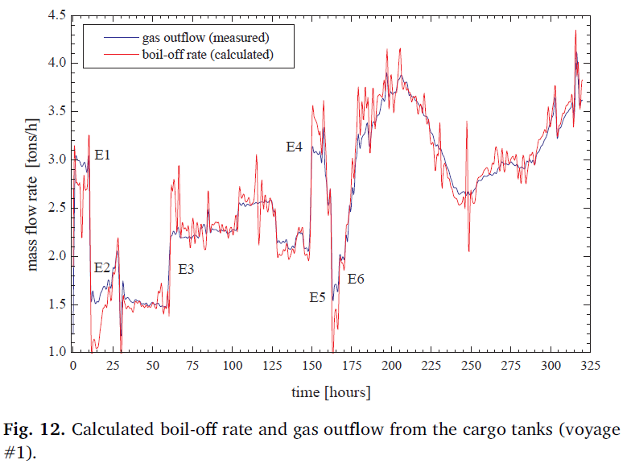
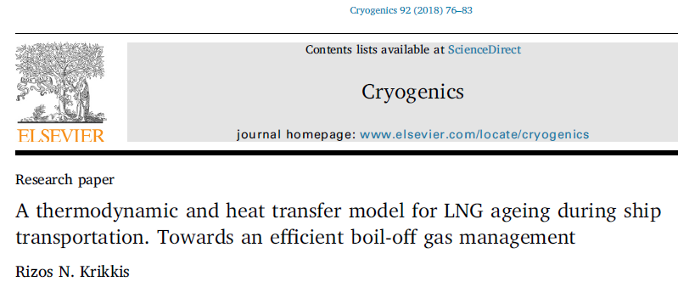
Voyage Analysis
Gas Management for LNG carriers.
Boil-Off-Rate Analysis of LNG carriers.
ANALYTICAL ENGINEERING

Slide 8
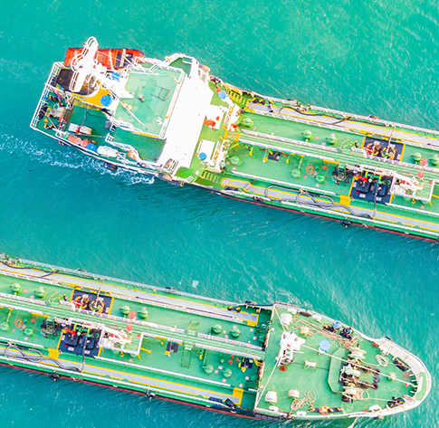
THANK YOU !
support@oceanking-engineering.gr

